Slide 1
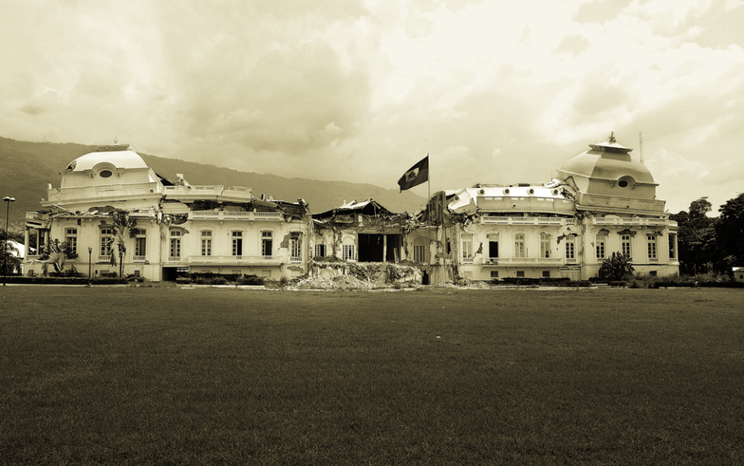
Humanitarian Logistics
A Simulation in Simio

Slide 2

Team Members
Daniel Dittenhafer
Jay Narhan

Slide 3

Background
Development
Longer term programs in stable areas that are aimed at raising the standard of living of a population of beneficiaries over the longer term.
Disaster
Humanitarian interventions that are started with limited notice, are relatively short in duration and are aimed at immediate life saving and life prolonging activities for the beneficiaries over the shorter term.

Slide 4
Relief Logistics
“The basic task of a logistics system is to deliver the appropriate supplies in good condition, in quantities required, and at the place and time they are needed”
Logistics, UNDP Disaster Management Training Program

Slide 5
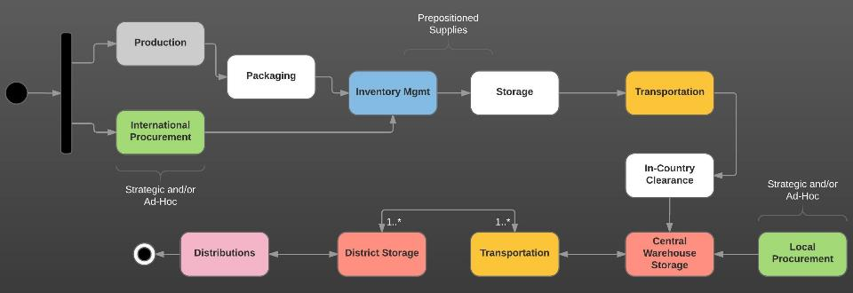
International Logistics Chain
Notes:
Can be very complex.
Example Procurement:
Is it One time purchase or Establishing a supply chain?
Do we source Local or are there Global Agreement
Is procurement Off the shelf, is there a Tendering and bidding process
What Framework agreement are in place
What agreement are there on Payment
What are the INCOTERMS

Slide 6
Objective
Model key aspects of the Humanitarian Logistics Chain (HLC) using Computer Simulation System
Model the movement of supplies (relief aid)
Include the last-mile component

Slide 7
Creating the Model
Entities
Suppliers
Relief Supplies
Warehouse
Transportation
Distribution Sites
Beneficiaries
Termination Simulation
T_{E} = 21 Days
Notes:
Terminating Simulation

Slide 8
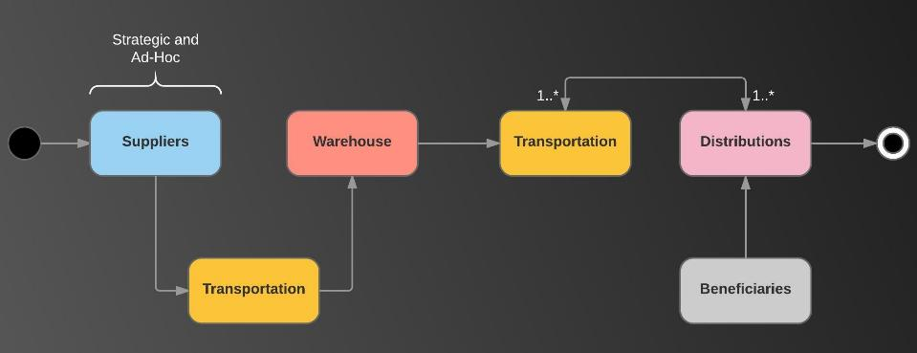
HLC Model Simplification

Slide 9
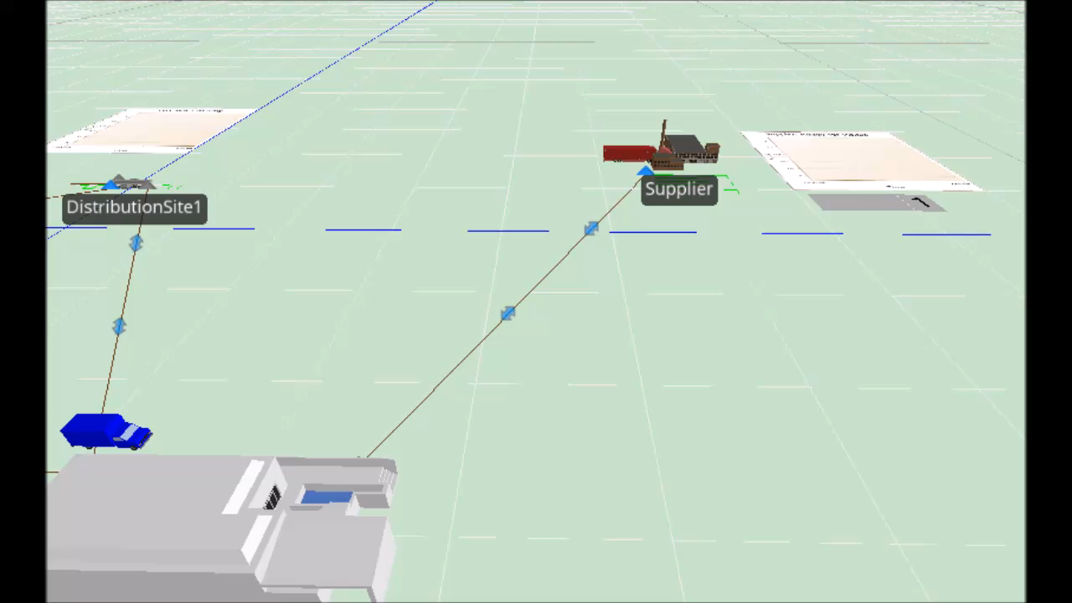
The Model in Action
Insert video of model in action

Slide 10
Significant Model Parameters
Name | Value | Units
DisasterTimeOffset | 3 | Days
DisasterVictimMaximumArrivals (per Dist Site) | 10000 | Beneficiaries
DistSiteProcessingTime | Random.Exponential(1) | Minutes
Entry2DistSitePath | TimePathToDistSite2 | Path Name
ReliefBeneficiaryInterarrivalTime | Random.Exponential(2.5) | Minutes
SupplierMaximumArrivals | Infinity | Relief Supply Items
SupplierReliefSuppliesInterarrivalTime | Random.Normal(1, 0.01) | Minutes
SupplierTravelTimeToWarehouse | Random.Normal(6,0.5) | Hours
SupplierVehicleCapacity | 5000 | Relief Supply Items
WarehouseStorageCapacity | Infinity | Relief Supply Items
WarehouseTravelTimeToDistributionSite1 | Random.Normal(6,0.5) | Hours
WarehouseTravelTimeToDistributionSite2 | Random.Normal(6,0.5) | Hours
WarehouseVehicleCapacity | 1000 | Relief Supply Items
WarehouseVehicleUptimeBetweenFailures | Random.Exponential(100) | Hours

Slide 11
Experiments
Reliability of supply pipeline
Impact of Ad-Hoc versus Preferential Supplier Partners
Breakdown of vehicles == delay of arrival of supplies
Modeling distance from storage to distribution sites
Closing access to beneficiaries – closing distribution sites
Impact on numbers served
Impact on queue time on available sites

Slide 12
Measurements
Time in System
Beneficiaries
Relief Supplies – Implications on perishable supplies
Waiting Time
Beneficiaries at Distribution Sites
Supplies distributed
(Number destroyed == Number distributed)

Slide 13
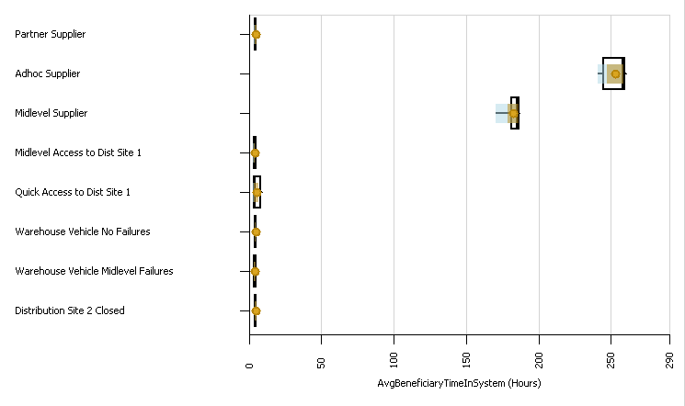
Results: Beneficiary Time in System

Slide 14
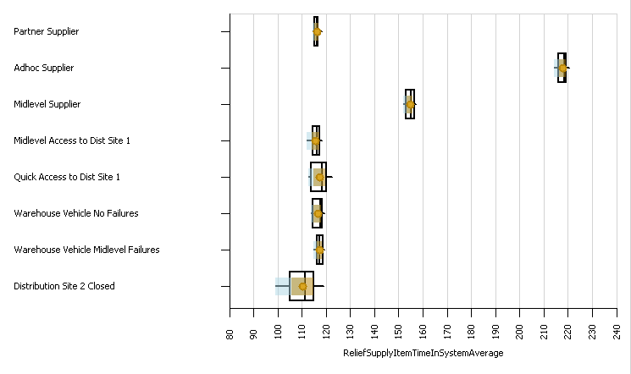
Results: Relief Supplies Time In System

Slide 15
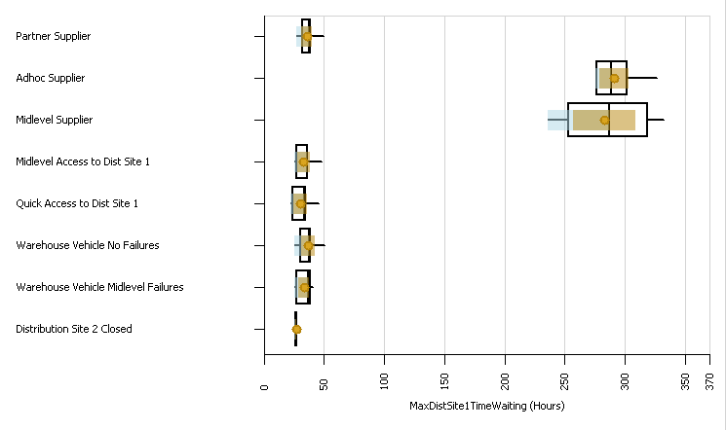
Results: Max Site 1 Waiting Time

Slide 16
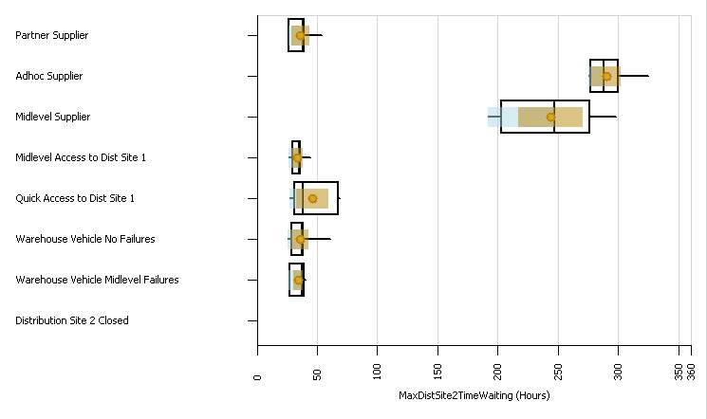
Results: Max Site 2 Waiting Time

Slide 17
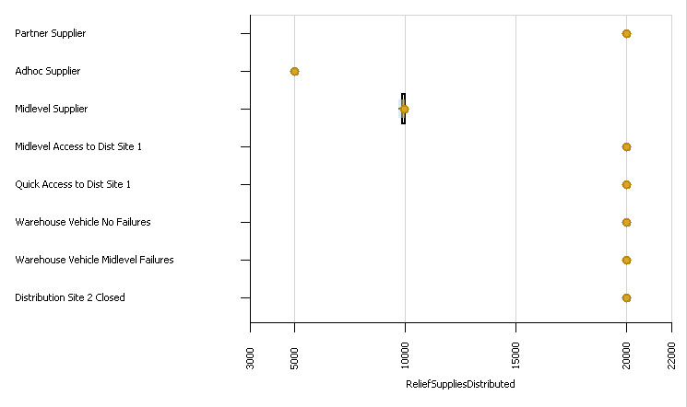
Results: Relief Supplies Distributed

Slide 18
Conclusions
Supplier Lead Time
Distribution Site Deliveries
Further Refinement of Model
Sensitivity Analyses of:
Beneficiary Interarrival Time
Distribution Site Processing Time
Financial Aspects

